Slide 1
Structural Design Patterns
Patterns and Antipatterns in Javascript
Chrysa Papadaki // chr.papadaki@tum.de
Nishant Gupta // nishant.gupta@tum.de
Master Seminar | Technische Universität München | Garching, 29.09.2015

Slide 2
Outline
Introduction
Structural Design Patterns
Applied Structural Patterns
Proxy
Decorator
Project 1: Songfinder
Facade
Composite
Project 2: drawr-bootstrap
Q&A
Structural Design Patterns | Chrysa Papadaki & Nishant Gupta | @TUM Garching, 29.09.2015

Slide 3
Introduction
The categories of object-oriented patterns formed by Gang of Four (GoF):
Creational patterns are used to create objects
Structural patterns are used to combine objects and classes in order to build structured objects
Behavioral patterns are used to build a computation and control data flows
Structural Design Patterns | Chrysa Papadaki & Nishant Gupta | @TUM Garching, 29.09.2015

Slide 4
Structural Design Patterns
Form larger structures from individual parts
Vary a great deal depending on what sort of structure is being created for what purpose
Use inheritance to compose interfaces or implementations
Structural Design Patterns | Chrysa Papadaki & Nishant Gupta | @TUM Garching, 29.09.2015

Slide 5
Structural Design Patterns (cont.)
Adapter
Bridge
Composite
Decorator
Facade
Flyweight
Proxy
Structural Design Patterns | Chrysa Papadaki & Nishant Gupta | @TUM Garching, 29.09.2015

Slide 6
Applied Structural Patterns
Adapter
Bridge
Composite
Decorator
Facade
Flyweight
Proxy
Structural Design Patterns | Chrysa Papadaki & Nishant Gupta | @TUM Garching, 29.09.2015

Slide 7
Proxy Design Pattern

Slide 8
Proxy Pattern - Definition
Provides a surrogate for another object to control access to it
Uses an extra level of indirection to support distributed, controlled, or intelligent access
Adds a wrapper to protect the real component from undue complexity
Structural Design Patterns | Chrysa Papadaki & Nishant Gupta | @TUM Garching, 29.09.2015

Slide 9
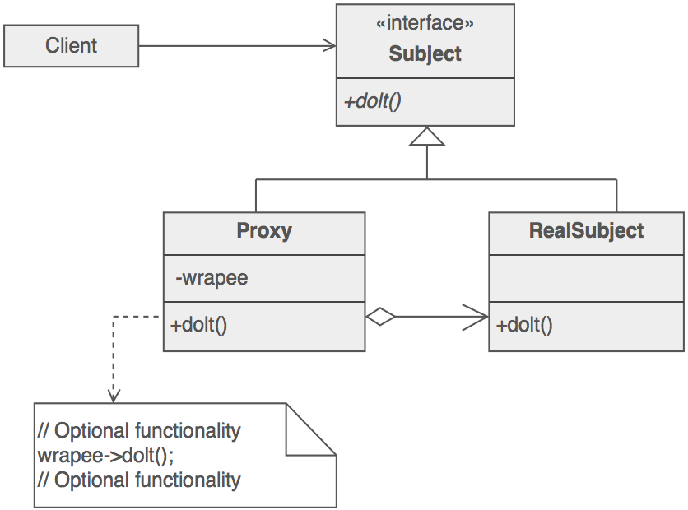
Proxy Pattern - Structure
Structural Design Patterns | Chrysa Papadaki & Nishant Gupta | @TUM Garching, 29.09.2015

Slide 10
Proxy Pattern - Applicability
Virtual Proxies delay initialization of expensive objects
Remote Proxies represent locally a remote object
Protection Proxies control access to a sensitive object
Smart References interpose additional actions when an object is accessed
Structural Design Patterns | Chrysa Papadaki & Nishant Gupta | @TUM Garching, 29.09.2015

Slide 11
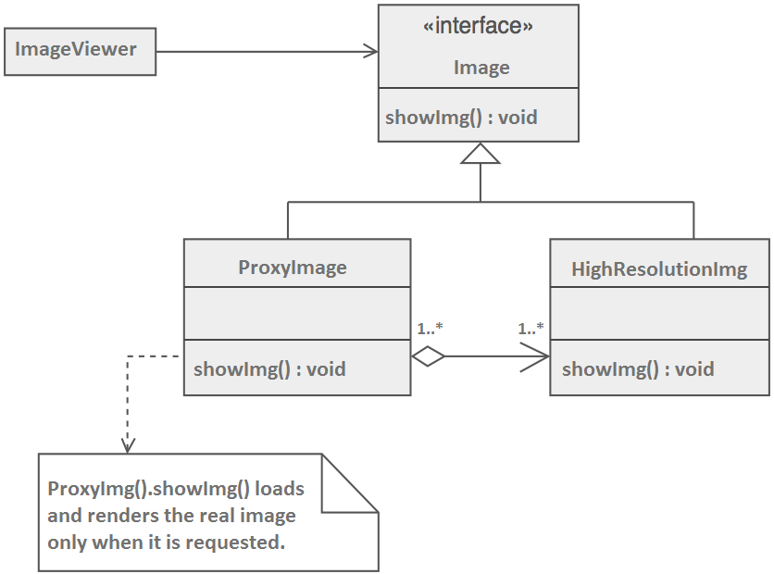
Proxy Pattern - Example
Structural Design Patterns | Chrysa Papadaki & Nishant Gupta | @TUM Garching, 29.09.2015

Slide 12
Proxy Pattern - Trade-off
Less efficiency due to indirection
Complex implementation
Structural Design Patterns | Chrysa Papadaki & Nishant Gupta | @TUM Garching, 29.09.2015

Slide 13
Decorator Design Pattern

Slide 14
Decorator Pattern - Definition
Attaches additional functionality dynamically
An alternative to subclassing for extending functionality
Encourages code reuse
A.k.a. Wrapper
Structural Design Patterns | Chrysa Papadaki & Nishant Gupta | @TUM Garching, 29.09.2015

Slide 15
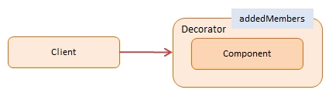
Decorator Pattern - High Level
Structural Design Patterns | Chrysa Papadaki & Nishant Gupta | @TUM Garching, 29.09.2015

Slide 16
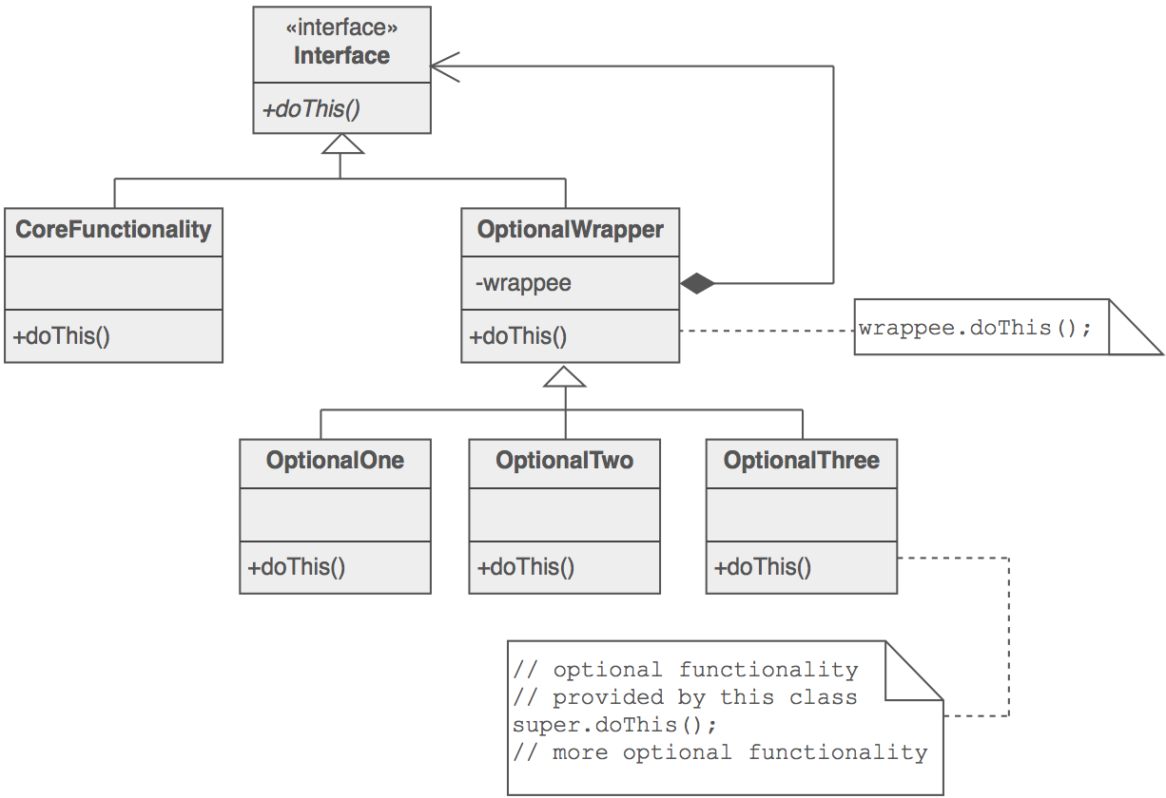
Decorator Pattern - Structure
Structural Design Patterns | Chrysa Papadaki & Nishant Gupta | @TUM Garching, 29.09.2015

Slide 17
Decorator Pattern - Example
var User = function(name) {
this.name = name;
this.say = function() {
log.add("User: " + this.name);
};
}
A User object is going to be enhanced by a DecoratedUser object
Structural Design Patterns | Chrysa Papadaki & Nishant Gupta | @TUM Garching, 29.09.2015

Slide 18
Decorator Pattern - Example (cont)
var DecoratedUser = function(user, street, city) {
this.user = user;
this.name = user.name; // ensures interface stays the same
this.street = street;
this.city = city;
this.say = function() {
log.add("Decorated User: " + this.name + ", " +
this.street + ", " + this.city);
};
}
Structural Design Patterns | Chrysa Papadaki & Nishant Gupta | @TUM Garching, 29.09.2015

Slide 19
Decorator Pattern - Example (cont)
function run() {
var user = new User("Andreas");
user.say();
var decorated = new DecoratedUser(user, "Bolzstr", "Ulm");
decorated.say();
log.show();
}
console >
User: Andreas
Decorated User: Andreas, Bolzstr, Ulm
Structural Design Patterns | Chrysa Papadaki & Nishant Gupta | @TUM Garching, 29.09.2015

Slide 20
Decorator Pattern - Trade-off
Decorators can result in many small objects
Overuse can be complex
Structural Design Patterns | Chrysa Papadaki & Nishant Gupta | @TUM Garching, 29.09.2015

Slide 21
Project: songFinder

Slide 22
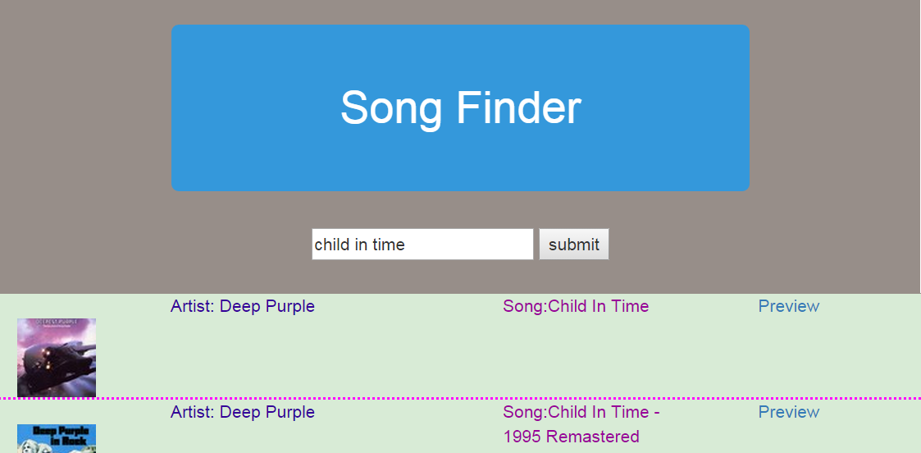
songFinder
Song search engine using spotify web services
Structural Design Patterns | Chrysa Papadaki & Nishant Gupta | @TUM Garching, 29.09.2015

Slide 23
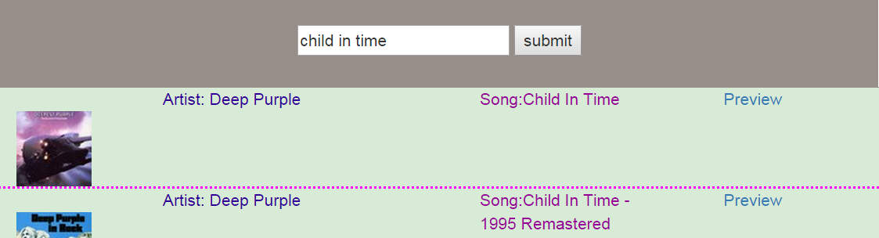

songFinder - Song Preview
Preview
Structural Design Patterns | Chrysa Papadaki & Nishant Gupta | @TUM Garching, 29.09.2015

Slide 24
songFinder - Single Result
On single result the song plays automatically - no need to press Preview
image to be changed...
Structural Design Patterns | Chrysa Papadaki & Nishant Gupta | @TUM Garching, 29.09.2015

Slide 25

songFinder - Symptoms
No caching: everytime long list of songs is being fetched and rendered
Tight coupling: parsing and rendering the ws response in one place
Code Smells:
// display(createSongsObj(getSongArray(data), Song) );
Structural Design Patterns | Chrysa Papadaki & Nishant Gupta | @TUM Garching, 29.09.2015

Slide 26
songFinder - Refactoring using Proxy
Structural Design Patterns | Chrysa Papadaki & Nishant Gupta | @TUM Garching, 29.09.2015

Slide 27
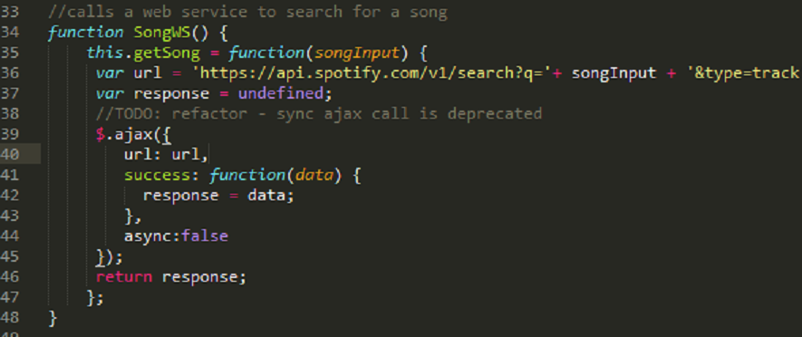
songFinder - Refactoring using Proxy
Structural Design Patterns | Chrysa Papadaki & Nishant Gupta | @TUM Garching, 29.09.2015

Slide 28
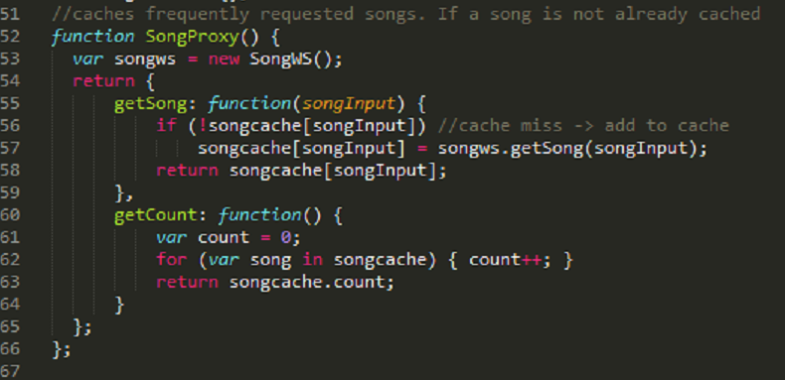
songFinder - Refactoring using Proxy (cont)
Structural Design Patterns | Chrysa Papadaki & Nishant Gupta | @TUM Garching, 29.09.2015

Slide 29
songFinder - Refactoring using Proxy (cont)
Provides an interface similar to the real object
Maintains a reference that lets the proxy access the real object
Handles requests and forwards these to the real object
Structural Design Patterns | Chrysa Papadaki & Nishant Gupta | @TUM Garching, 29.09.2015

Slide 30
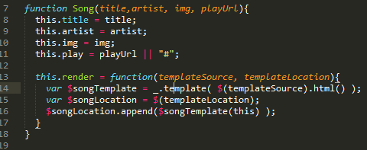
songFinder - Refactoring using Decorator I
Simple Song Object
Structural Design Patterns | Chrysa Papadaki & Nishant Gupta | @TUM Garching, 29.09.2015

Slide 31
songFinder - Refactoring using Decorator I
Decorated Song Object - Playable Song
image to be added
Structural Design Patterns | Chrysa Papadaki & Nishant Gupta | @TUM Garching, 29.09.2015

Slide 32
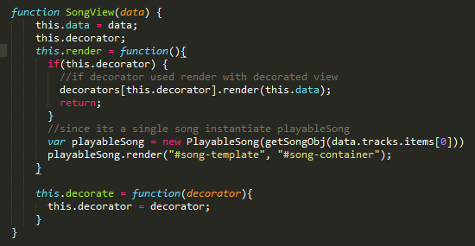
songFinder - Refactoring using Decorator II
Structural Design Patterns | Chrysa Papadaki & Nishant Gupta | @TUM Garching, 29.09.2015

Slide 33
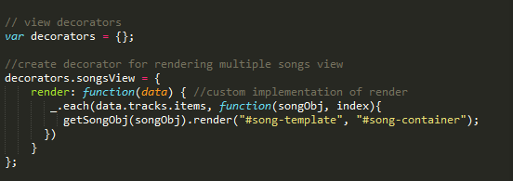
songFinder - Refactoring using Decorator II
Structural Design Patterns | Chrysa Papadaki & Nishant Gupta | @TUM Garching, 29.09.2015

Slide 34
songFinder - Refactoring using Decorator II
We achieved to:
change efficiently the Song object behavior based on the response format at runtime
provide a clean and object-oriented way to handle and render different server responses
Structural Design Patterns | Chrysa Papadaki & Nishant Gupta | @TUM Garching, 29.09.2015

Slide 35
Façade Design Pattern

Slide 36
Façade Pattern - Definition
Convenient higher-level interface to a larger body of code
Hides actual complexity
Simplified presentation of API - Improves usability
Decouples class from code that utilizes it
Structural Design Patterns | Chrysa Papadaki & Nishant Gupta | @TUM Garching, 29.09.2015
Notes:
provides a convenient higher-level interface to a larger body of code
Hiding actual complexity
Improves usability because of simplified presentation of API
Not only simplifies the class interface, but also decouples class from code that utilizes it

Slide 37
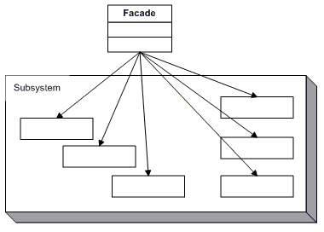
Façade Pattern - Structure
Structural Design Patterns | Chrysa Papadaki & Nishant Gupta | @TUM Garching, 29.09.2015
Notes:
provides a convenient higher-level interface to a larger body of code
Hiding actual complexity
Improves usability because of simplified presentation of API
Not only simplifies the class interface, but also decouples class from code that utilizes it

Slide 38

Example
Structural Design Patterns | Chrysa Papadaki & Nishant Gupta | @TUM Garching, 29.09.2015

Slide 39
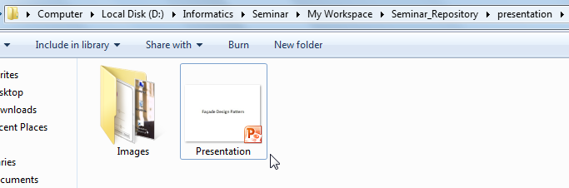
Example
Structural Design Patterns | Chrysa Papadaki & Nishant Gupta | @TUM Garching, 29.09.2015

Slide 40
Example - jQuery
Group of facades – makes programming easier and faster
Structural Design Patterns | Chrysa Papadaki & Nishant Gupta | @TUM Garching, 29.09.2015
Notes:
Being used by people knowingly or unknowingly in jQuery
jQuery essentially serves as a group of facades to make our lives as programmers easier

Slide 41
Example - jQuery
Group of facades – makes programming easier and faster
facades for $.ajax()
$.get( url, data, callback, dataType );
$.post( url, data, callback, dataType );
$.getJSON( url, data, callback );
Structural Design Patterns | Chrysa Papadaki & Nishant Gupta | @TUM Garching, 29.09.2015
Notes:
Being used by people knowingly or unknowingly in jQuery
jQuery essentially serves as a group of facades to make our lives as programmers easier

Slide 42
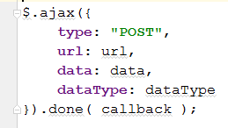
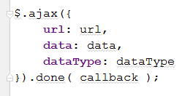

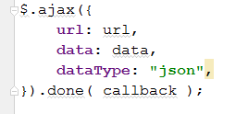
Behind the scenes
Structural Design Patterns | Chrysa Papadaki & Nishant Gupta | @TUM Garching, 29.09.2015

Slide 43
Composite Design Pattern

Slide 44
Composite Pattern - Introduction
Group of objects should be treated in the same way as a single instance of an object.
Same behavior applied to an object or a group of objects
Code resuability
Structural Design Patterns | Chrysa Papadaki & Nishant Gupta | @TUM Garching, 29.09.2015

Slide 45
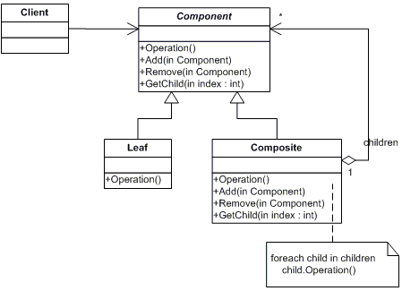
Composite Pattern - Structure
Structural Design Patterns | Chrysa Papadaki & Nishant Gupta | @TUM Garching, 29.09.2015

Slide 46
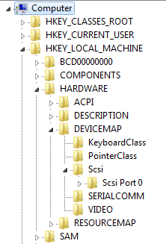
Example
Component
Leaf
Component
Leaf
Component
Structural Design Patterns | Chrysa Papadaki & Nishant Gupta | @TUM Garching, 29.09.2015

Slide 47


Example - jQuery
Same methods available to be applied to an element or collection of elements
Single Element
Collection of Elements
Structural Design Patterns | Chrysa Papadaki & Nishant Gupta | @TUM Garching, 29.09.2015
Notes:
Being used by people knowingly or unknowingly in jQuery
jQuery essentially serves as a group of facades to make our lives as programmers easier

Slide 48
Project : drawr-bootstrap^{[1]}

Slide 49
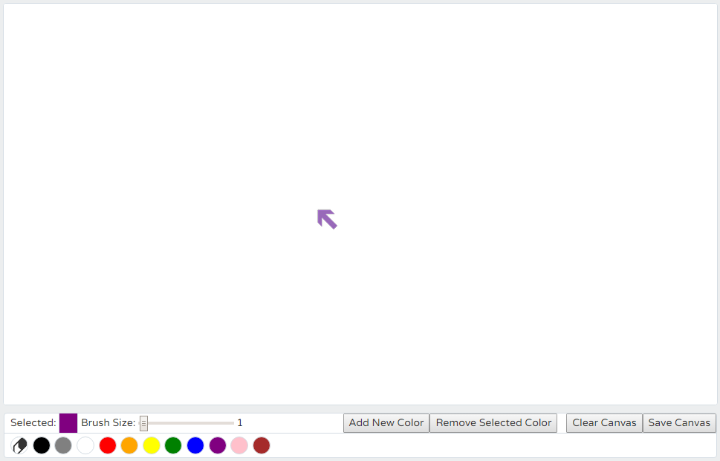

drawr-bootstrap
First Screen
Structural Design Patterns | Chrysa Papadaki & Nishant Gupta | @TUM Garching, 29.09.2015

Slide 50
drawr-bootstrap: features
Customizable drawing tool
Toolbar
Brush/Eraser thickness
Color Palette
Add new color
Remove a color
Clear canvas
Save canvas
Structural Design Patterns | Chrysa Papadaki & Nishant Gupta | @TUM Garching, 29.09.2015

Slide 51
Applying Façade Design Pattern

Slide 52
Several event listeners & handlers
$('#palette').on('click', 'li', function () {…}
$('#erase').click(function () { …}
$('#thickness').change(function () {…}
$('#eraserthickness').change(function () {…}
$('#save').click(function () {…}
$('#clear').click(function () {…}
$('#addcolor').click(function () {…}
$('#removecolor').click(function () {…}
$('#attachcolor').click(function () {…}
$('#cancelcolor').click(function () {…}
$('.colorslider').change(function () {…}
Structural Design Patterns | Chrysa Papadaki & Nishant Gupta | @TUM Garching, 29.09.2015

Slide 53
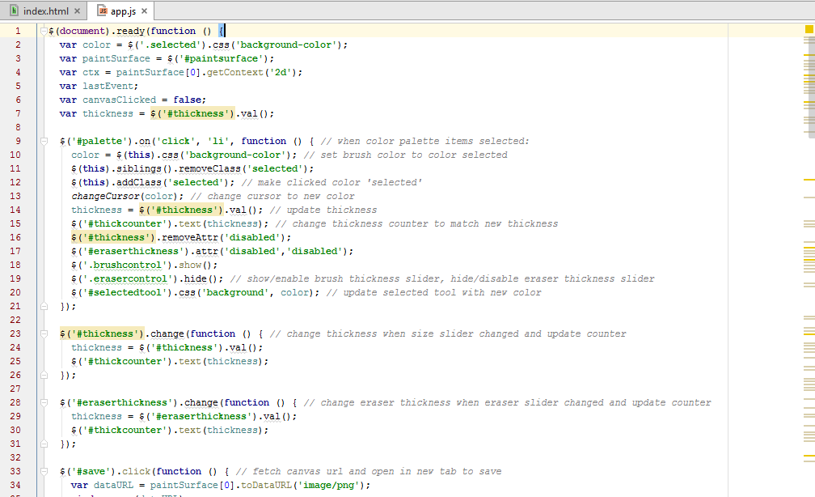
Original Version
app.js
Structural Design Patterns | Chrysa Papadaki & Nishant Gupta | @TUM Garching, 29.09.2015

Slide 54
Limitations
All event listeners/handlers defined in a single function
Confusing! No abstraction
Browsers’ compatibility not checked
app.js
Structural Design Patterns | Chrysa Papadaki & Nishant Gupta | @TUM Garching, 29.09.2015

Slide 55
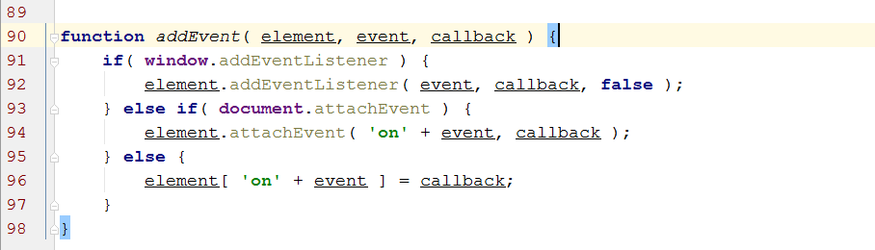
a simple facade that masks the various browser-specific methods
app.js
Structural Design Patterns | Chrysa Papadaki & Nishant Gupta | @TUM Garching, 29.09.2015
Notes:
Simplify an interface for listening to events
Create a common method that can be used in one’s code which does the task of checking for the existence of features so that it can provide a safe and cross-browser compatible solution

Slide 56
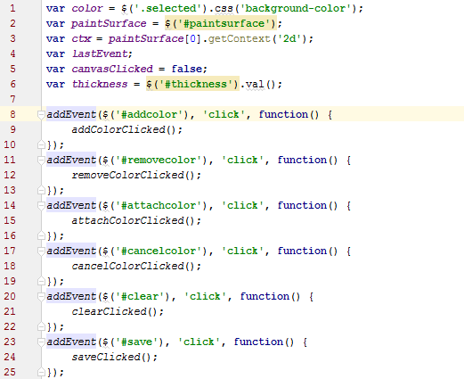
app.js
Structural Design Patterns | Chrysa Papadaki & Nishant Gupta | @TUM Garching, 29.09.2015

Slide 57
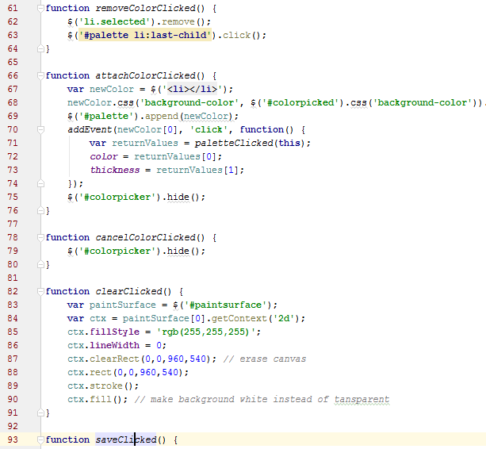
Achieving abstraction
eventHandler.js
Structural Design Patterns | Chrysa Papadaki & Nishant Gupta | @TUM Garching, 29.09.2015

Slide 58
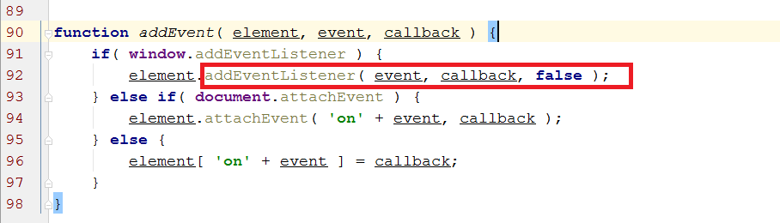

Browser-specific methods
Structural Design Patterns | Chrysa Papadaki & Nishant Gupta | @TUM Garching, 29.09.2015

Slide 59
Applying Composite Design Pattern

Slide 60
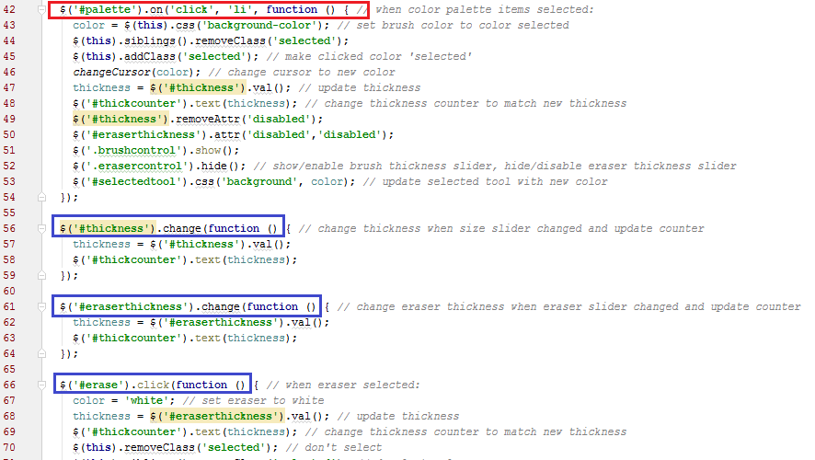
Original version
Component with collection of list elements
Single element component
Structural Design Patterns | Chrysa Papadaki & Nishant Gupta | @TUM Garching, 29.09.2015

Slide 61
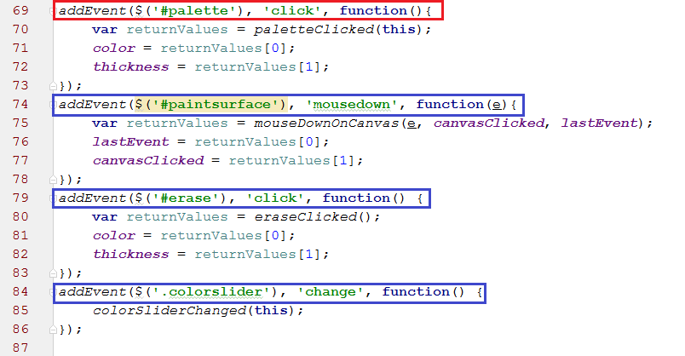
Refactored version
Component with collection of list elements
Single element
component
Structural Design Patterns | Chrysa Papadaki & Nishant Gupta | @TUM Garching, 29.09.2015

Slide 62
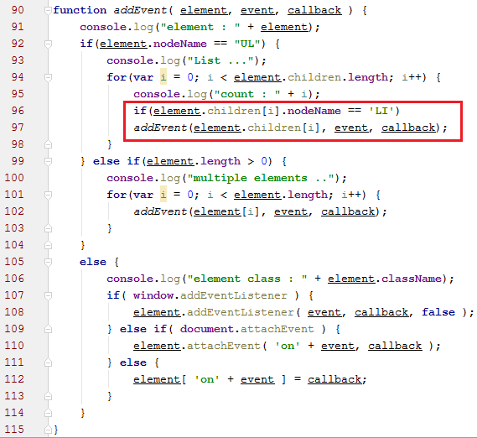
Refactored version
Recursion for
Collection components
Structural Design Patterns | Chrysa Papadaki & Nishant Gupta | @TUM Garching, 29.09.2015

Slide 63
References
[1] drawr-bootstrap
https://github.com/flamingveggies/drawr-bootstrap
[2] Sourcemaking
https://sourcemaking.com/design_patterns/structural_patterns
[3] songFinder
https://github.com/goodbedford/songFinder
[4] dofactory
http://www.dofactory.com/javascript/design-patterns
[5] gofpatterns
http://www.gofpatterns.com

Slide 64
Q&A
Thank you
Questions?
Chrysa Papadaki // chr.papadaki@tum.de
Nishant Gupta // nishant.gupta@tum.de
Structural Design Patterns | Chrysa Papadaki & Nishant Gupta | @TUM Garching, 29.09.2015

